Slide 1
Project Hashtag Storyboard
College Assignment Writing
An Introduction

Slide 2
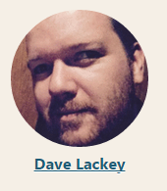
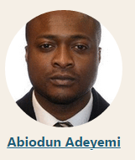
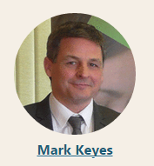
Creator’s:

Slide 3
Roles & Responsibilities
Joan Hughes
Develop Microsoft Office Storyboard.
Mark Keyes
Develop Referencing Storyboard.
Dave Lackey
Provide guidance of the storyboard development to incorporate features of Articulate Storyline.
Abiodun Adeyemi
Accumulate all of the theory underpinning the project.

Slide 4
Aim & Learning Objectives
This course has been designed to bridge the gap in the knowledge of Microsoft Word and APA referencing style for students who have completed a leaving certificate and wish to pursue further studies in college.
Referencing
Assignment Writing
Taking care of your document.
Formatting text.
Proofing your document.
Printing
What is referencing?
Why do you need to reference?
When do you need to reference?
Where do you place references?
How do you reference an author in the APA style

Slide 5
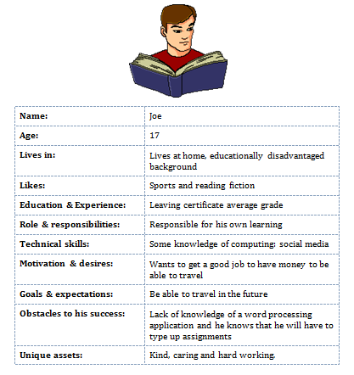
Persona

Slide 6
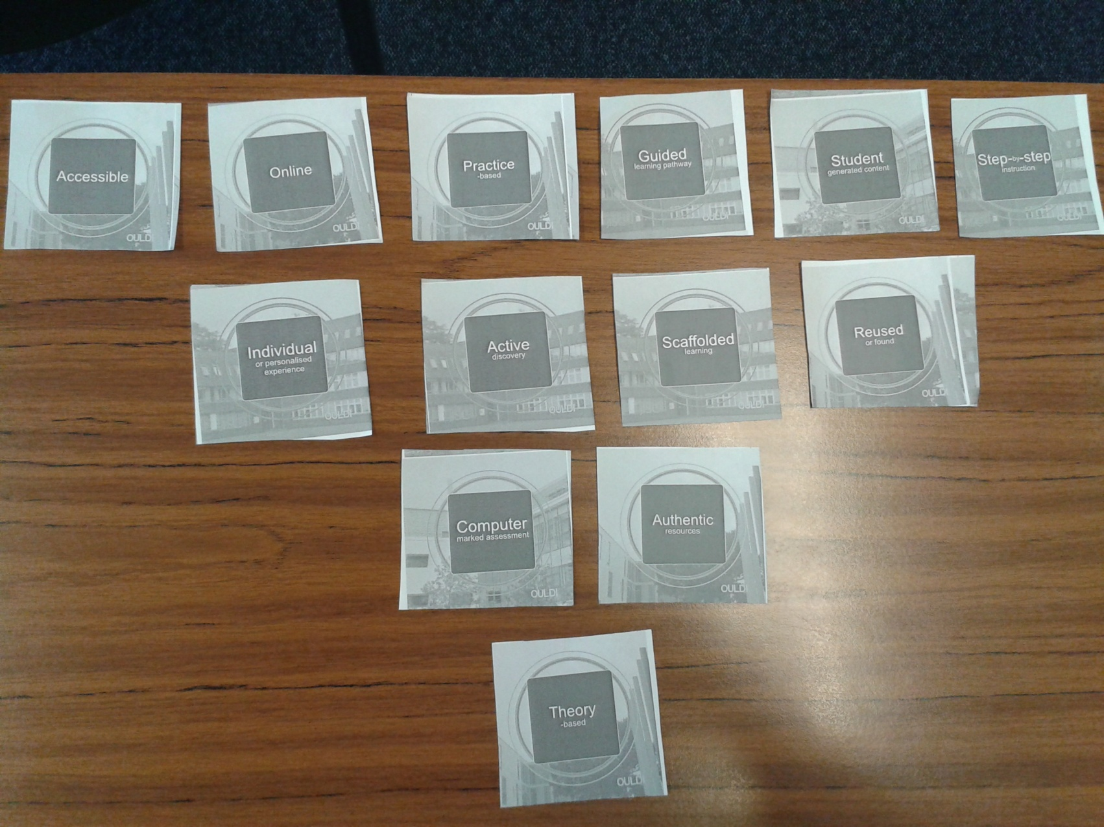
Use of ‘Actual Cards’ to establish Design Principles

Slide 7
Instructional Design Model - SAM
Design
Development
Evaluation
Start
End
The Successive Approximation Model evaluates instructional design at every stage from initiation to testing. With this model, the goal is to take smaller more flexible steps within a larger framework to achieve high quality in training and learning as opposed to following the rigid, step-by-step process.

Slide 8
Incorporating the SAM Model in the Group Project
Using the ID Model SAM we developed a:
Draft of guide produced in PowerPoint presentation.
Allowed for early feedback from group.
Allowed for group evaluation and decisions on improvements.

Slide 9
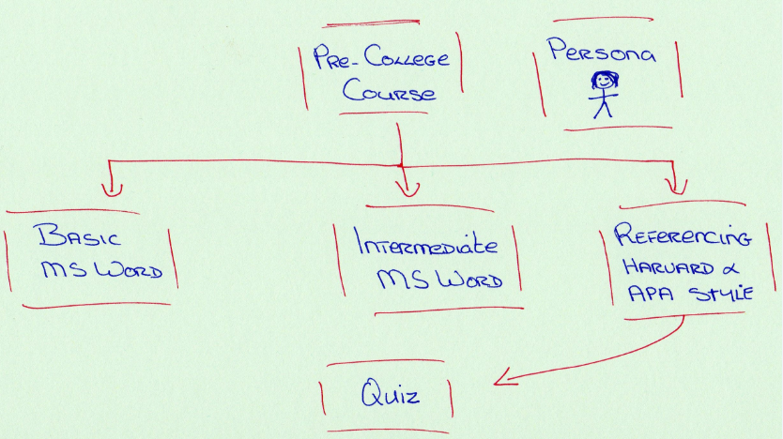
Original Concept

Slide 10
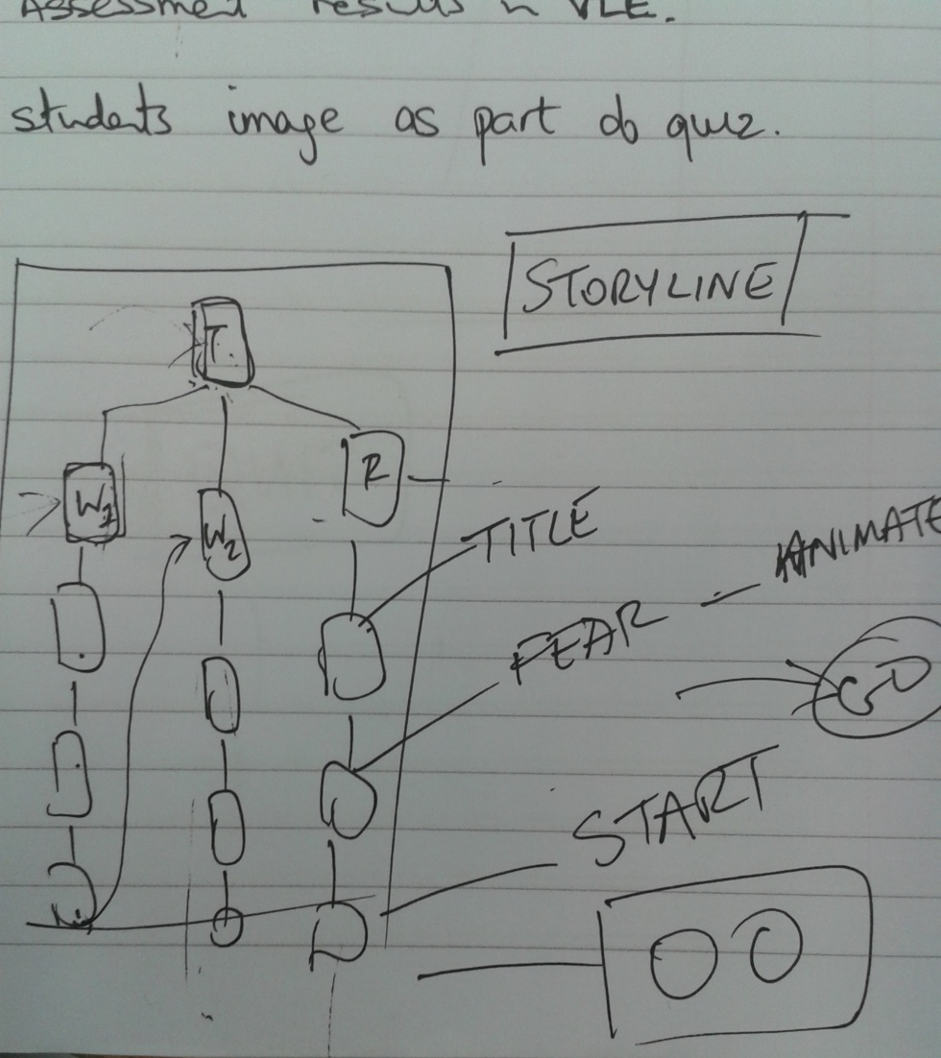
Image of layout of course to include branching

Slide 11
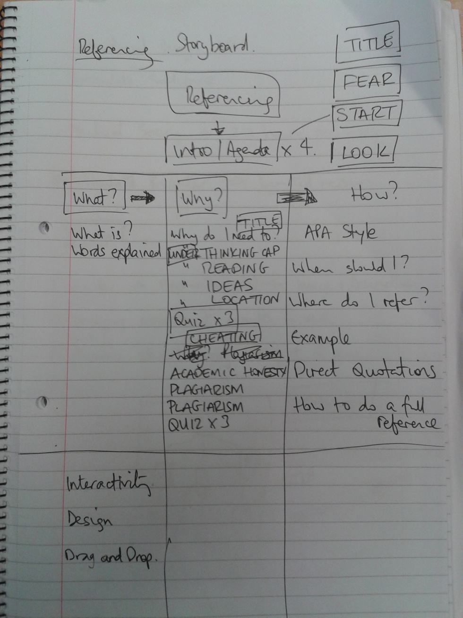
Refining the Design

Slide 12
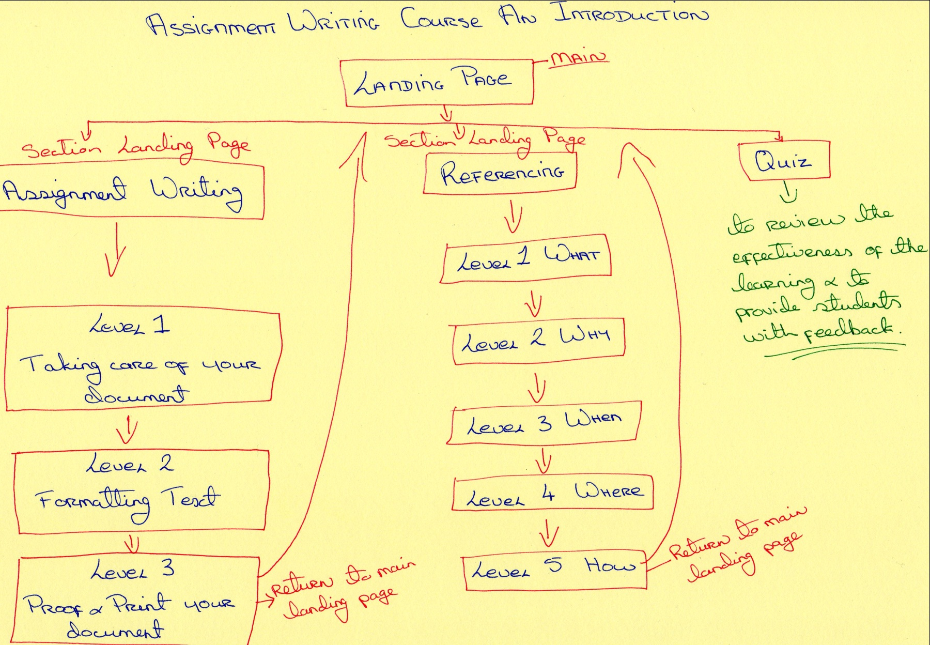
Current Concept

Slide 13
Project Design Decisions
The use of Articulate software to enhance resource structure and interactivity.
Agreement to stream the What, Why and How into separate streams (described as levels), chunking the material to avoid cognitive overload
Agreed to require progressive completion of levels (video gaming analogy) to appeal to the target cohort
Suggestions made on tone, look and scope of content
Agreement reached on suitability for target cohort (based on persona)

Slide 14
Project Storyboard
Come along for a trip through our storyboard we hope you enjoy.

Slide 15
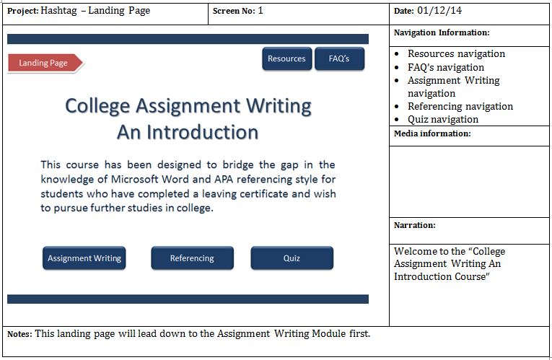
Main Landing Page

Slide 16
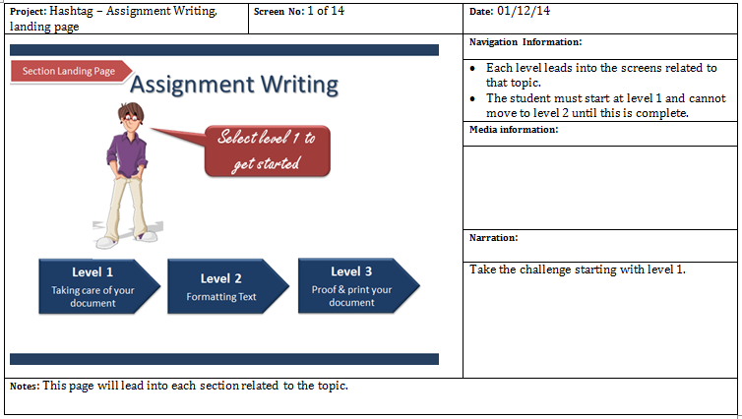
Assignment Writing – Landing Page

Slide 24
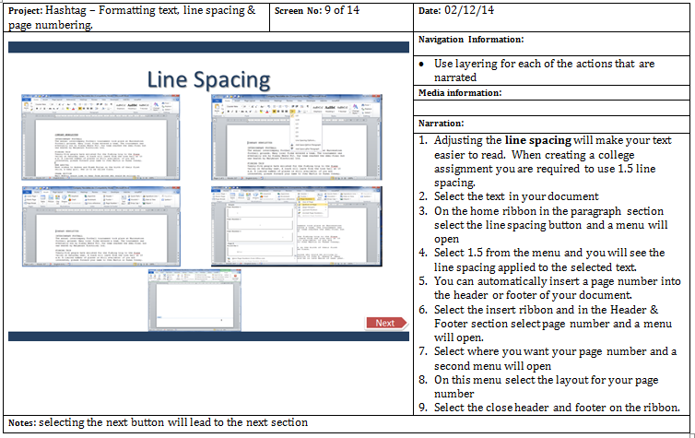

Slide 25
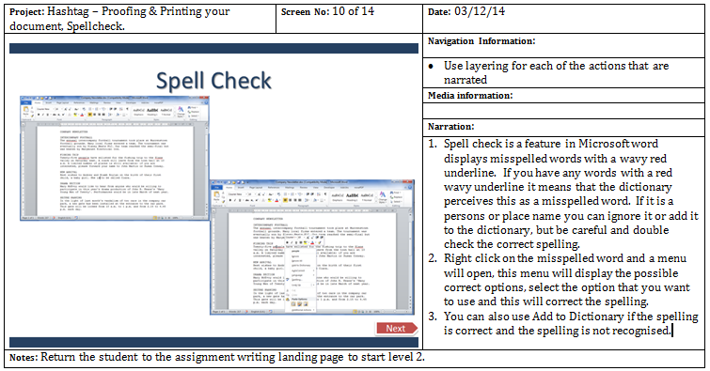

Slide 28
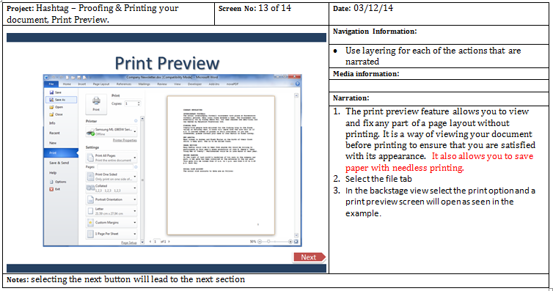

Slide 29
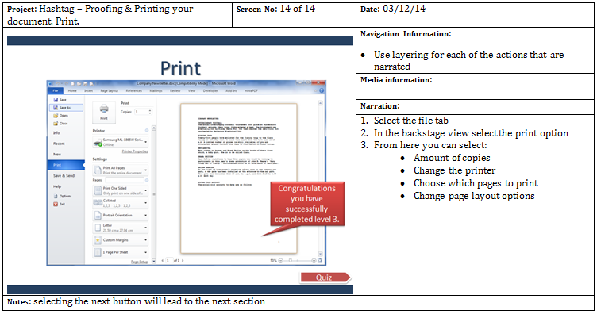

Slide 30
Referencing – Landing Page

Slide 31
Sample PowerPoint Slides

Slide 32
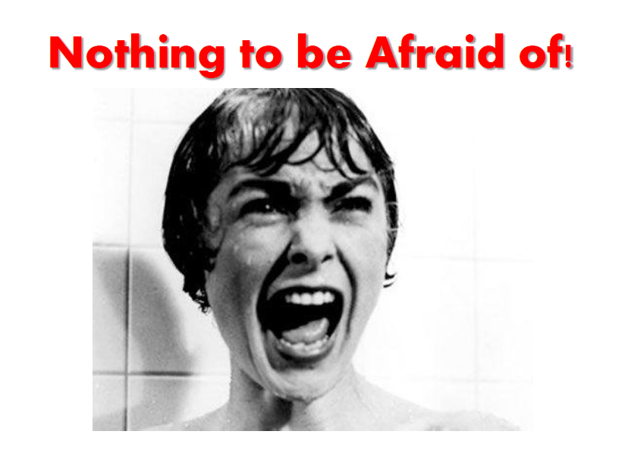
Sample PowerPoint Slides

Slide 33
Sample PowerPoint Slides

Slide 34
Draft Storyboard

Slide 35
Draft Storyboard

Slide 36
Draft Storyboard

Slide 37
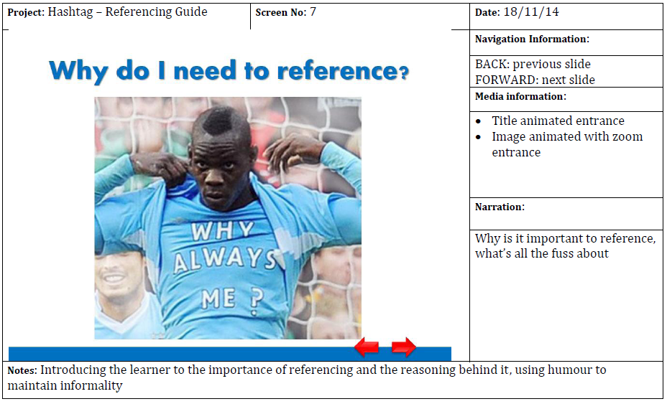
Draft Storyboard

Slide 38
Draft Storyboard

Slide 39
Draft Storyboard

Slide 40
Draft Storyboard

Slide 41
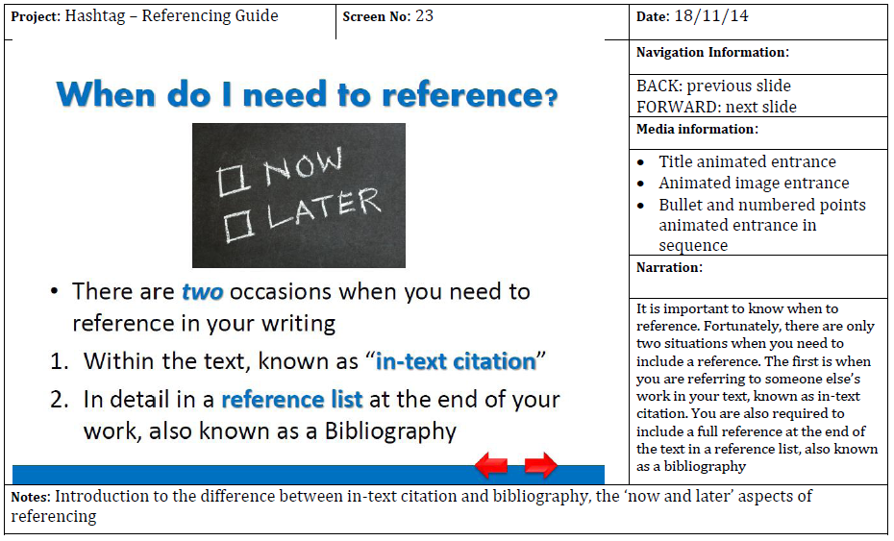
Draft Storyboard

Slide 42
Draft Storyboard

Slide 43
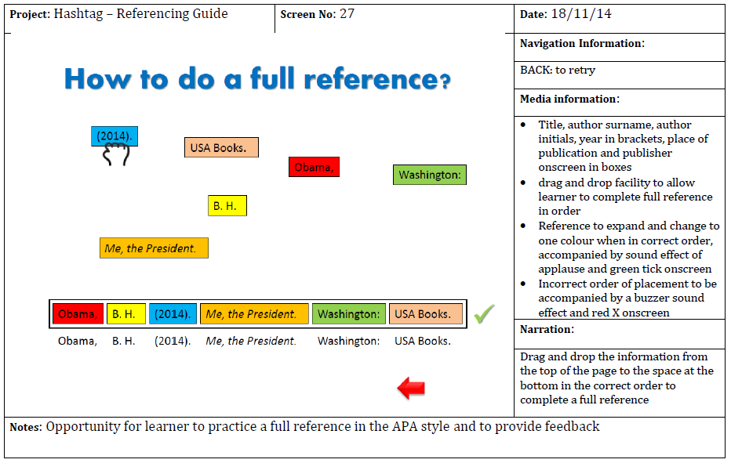
Draft Storyboard

Slide 44
Quiz Slides?
The quiz questions will be developed to incorporate higher order thinking.

